Slide 1
OADII Software Foundry: Programming Language Skills Essentials: Introduction to C++: Inheritance
Dean Hougen
School of Computer Science
University of Oklahoma

Slide 2
A Hierarchical, Object-Oriented World
The entities in the world around us often have similarities to one another
In biology, species of plants and animals are organized into related genera
In transportation, vehicles can be thought of as belonging to different categories such as cars, trucks, and motorcycles
The more specialized categories share properties of the more general category
We can represent the relationship between the more specialized categories and the more general categories as an inheritance hierarchy

Slide 3
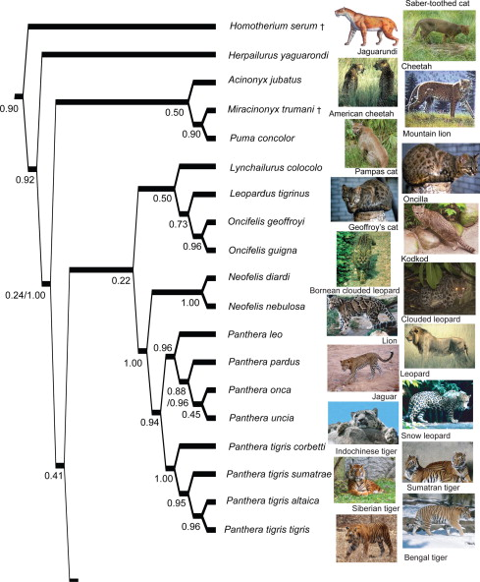
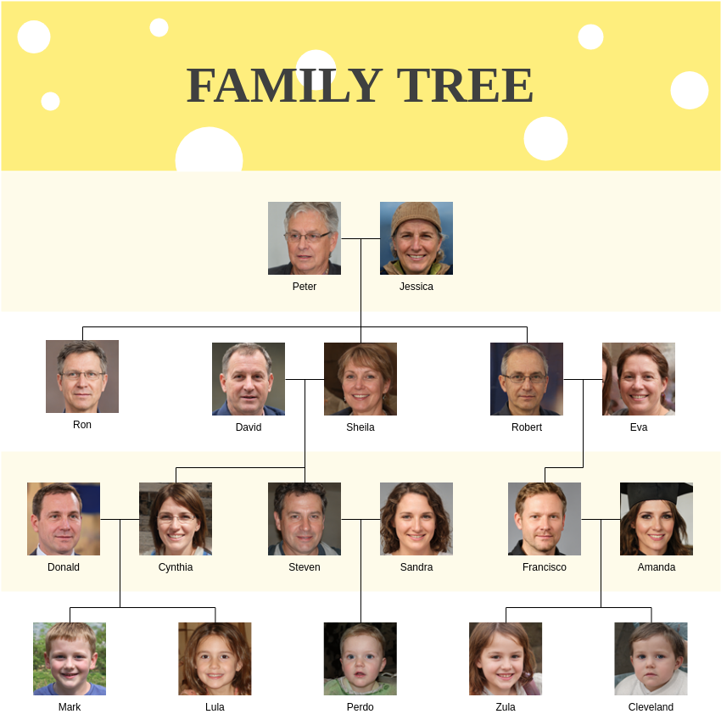
https://www.sciencedirect.com/science/article/pii/S1055790309004424#fig4
https://www.quora.com/What-is-the-difference-between-a-family-tree-and-a-phylogenetic-tree

Slide 4
Inheritance
Inheritance – Allowing one class to reuse the attributes and behavior of another class.
The class being inherited from is the Superclass
Also called a parent or base class
The class doing the inheriting is the Subclass
Also called a child class
The Subclass inherits all of the variables and methods from the Superclass
However, it can only access the public and protected variables and methods

Slide 5
Forms of Inheritance
Specialization
The subclass is a specialized form of the superclass
The subclass satisfies the specs of the superclass in all relevant aspects
The subclass inherits both the specs of a behavior and all/some of the behaviors provided by the superclass
This is the primary form of inheritance used in C++.
Specification (abstract class with pure virtual functions)
Superclass only defines the behavior
Subclass is responsible to implement the behavior
In C++, a class can implement multiple different abstract classes

Slide 6
Forms of Inheritance
Extension
Subclass adds new functionality
Does not change inherited behavior
Limitation
The subclass restricts the use of some of the behavior inherited from the superclass
Removes behaviors inherited by the superclass
Combination (Multiple Inheritance)
The subclass inherits features from multiple superclasses
C++ support this form of inheritance but introduces possible complications
Example: Diamond problem (see below)

Slide 7
Inheritance in UML
Inheritance is shown in UML by a line and a hollow arrow pointing from the Subclass to the Superclass:
Superclass
Subclass
Superclass variables
Subclass variables
Superclass methods
Subclass methods

Slide 8
Inheritance Example
Polygon inherits a center Point from Shape and overrides the getArea() method of Shape.
Polygon adds an array of corners to the center inherited from Shape.
Shape
Polygon
-center: Point
-corners[]: Point
+Shape(Point)
+getArea(): double
+Polygon(Point[])
+getArea(): double

Slide 9
Inheritance Hierarchies
The relationship between Superclasses and Subclasses is known as an Inheritance Hierarchy
In C++, there is no universal base class for all classes (no equivalent to the Java “Object” class), so there are multiple inheritance hierarchies in most C++ programs

Slide 10
Diamond Inheritance
Diamond inheritance happens when multiple inheritance is used within the same inheritance hierarchy
Student
-classSchedule: Schedule
Person
TeachingAssistant
+Student(String)
+getSchedule(): Schedule
-name: String
Instructor
+Person(String)
+getName(): String
+TeachingAssistant(String)
-teachingSchedule: Schedule
+Instructor(String)
+getSchedule(): Schedule

Slide 11
In-Class Exercise
Create an inheritance hierarchy for shapes
Include at least two levels below Shape and four shapes besides Shape and Polygon

Slide 12
Questions?

Slide 13
Composition in UML
Point
Often an object will contain other objects
This is shown with a line and note about how many of each object is contained
#x: double
#y: double
1
*
+getXPosition(): double
+getYPosition(): double
Shape
Polygon
-center: Point
-corners[]: Point
+Shape(Point)
+getArea(): double
+Polygon(Point[])
+getArea(): double

Slide 14
Aggregation in UML
Each address may be shared by up to three students
Student
Often an object will be shared by other objects
This is shown with a line with an open diamond and note about how many of each object is contained
…
1
1..3
…
1
1
Name
Address
…
…
…
…

Slide 15
Questions?

